Slide 1
Process Description and Control
Contents:
Process: Concept of a Process, Process States, Process Description, Process Control, Execution of an OS
Threads: Processes and Threads, Concept of Multithreading, Types of Threads, Thread programming.
Scheduling: Types of Scheduling algorithms and Thread Scheduling

Slide 2
What is Process?
A program in execution
An instance of a program running on a computer
The entity that can be assigned to and executed on a processor
A unit of activity characterized by the execution of a sequence of instructions, a current state, and an associated set of system instructions

Slide 3
Process Elements
  A process is comprised of:
    Program code (possibly shared)
    A set of data
    A number of attributes describing the state of the process

Slide 4
Process Elements
  While the process is running it has a number of elements including
    Identifier
    State
    Priority
    Program counter
    Memory pointers
    Context data
    I/O status information
    Accounting information

Slide 5
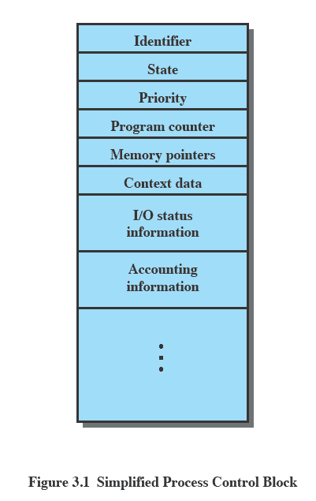
Process Control Block
  Contains the process elements
  Created and manage by the operating system
  Allows support for multiple processes

Slide 6
Trace of a Process
  The behavior of an individual process is shown by listing the sequence of instructions that are executed. This list is called a Trace
  Dispatcher is a small program which switches the processor from one process to another

Slide 7
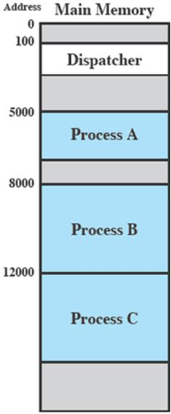
Process Execution
  Consider three processes being executed
  All are in memory (plus the dispatcher)
  Lets ignore virtual memory for this.

Slide 8
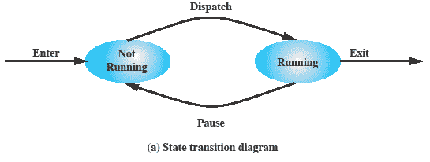
Two State Process Model
  Process may be in one of two states
    Running
    Not-running

Slide 9
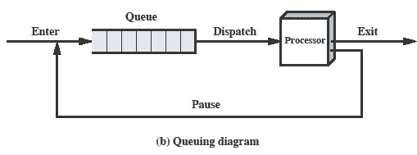
Queue
  Processes moved by the dispatcher of the OS to the CPU then back to the queue until the task is competed

Slide 10
Process Creation
  The OS builds a data structure to manage the process
  Traditionally, the OS created all processes, But it can be useful to let a running process create another
  This action is called process spawning
    Parent Process is the original, creating, process
    Child Process is the new process

Slide 11
Process Termination
  There must be some way that a process can indicate completion.
  This indication may be:
    A HALT instruction generating an interrupt alert to the OS.
    A user action (e.g. log off, quitting an application)
    A fault or error
    Parent process terminating

Slide 12
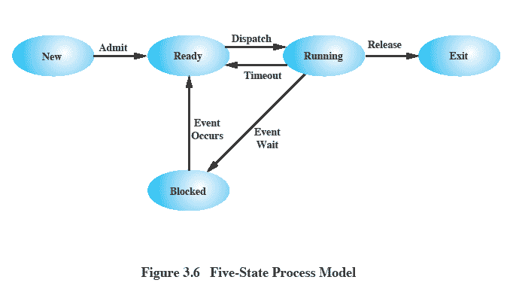
Five States Process Model

Slide 13
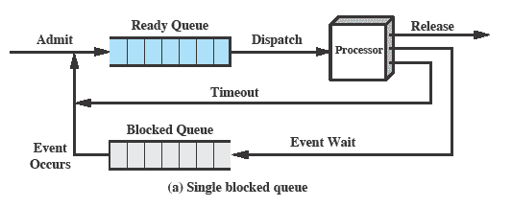
Multiple Queues

Slide 14
Suspended Processes
  Processor is faster than I/O so all processes could be waiting for I/O
    Swap these processes to disk to free up more memory and use processor on more processes
  Blocked state becomes suspend state when swapped to disk
  Two new states
    Blocked/Suspend
    Ready/Suspend

Slide 15
OS Control Structures
  For the OS is to manage processes and resources, it must have information about the current status of each process and resource.
  Tables are constructed for each entity the operating system manages

Slide 16
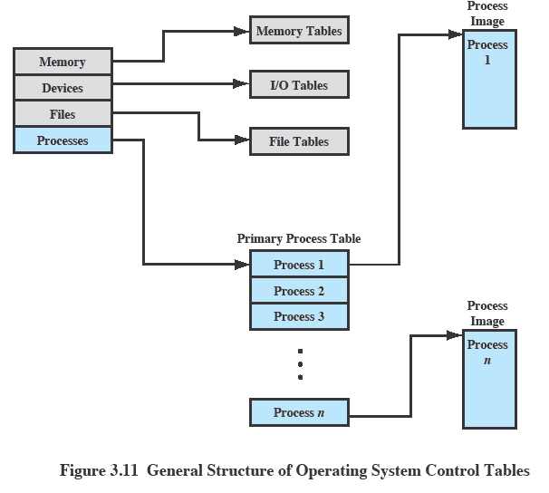
OS Control Tables

Slide 17
Memory Tables
  Memory tables are used to keep track of both main and secondary memory.
  Must include this information:
    Allocation of main memory to processes
    Allocation of secondary memory to processes
    Protection attributes for access to shared memory regions
    Information needed to manage virtual memory

Slide 18
IO Tables
  Used by the OS to manage the I/O devices and channels of the computer.
  The OS needs to know
    Whether the I/O device is available or assigned
    The status of I/O operation
    The location in main memory being used as the source or destination of the I/O transfer

Slide 19
File Tables
  These tables provide information about:
    Existence of files
    Location on secondary memory
    Current Status
    other attributes.
  Sometimes this information is maintained by a file management system

Slide 20
Process Tables
  To manage processes the OS needs to know details of the processes
    Current state
    Process ID
    Location in memory
  Process control block
    Process image is the collection of program. Data, stack, and attributes

Slide 21
Process Attributes
We can group the process control block information into three general categories:
    Process identification
    Processor state information
    Process control information

Slide 22
Process Identification
  Each process is assigned a unique numeric identifier.
  Many of the other tables controlled by the OS may use process identifiers to cross-reference process tables

Slide 23
Processor State Information
This consists of the contents of processor registers.
    User-visible registers
    Control and status registers
    Stack pointers
Program status word (PSW)
    contains status information
    Example: the EFLAGS register on Pentium processors

Slide 24
Process Control Block
  The most important data structure in an OS
    It defines the state of the OS
  Process Control Block requires protection
    A faulty routine could cause damage to the block destroying the OS’s ability to manage the process
    Any design change to the block could affect many modules of the OS

Slide 25
Modes of Execution
Most processors support at least two modes of execution
User mode
    Less-privileged mode
    User programs typically execute in this mode
System mode
    More-privileged mode
    Kernel of the operating system

Slide 26
Process Creation
Once the OS decides to create a new process it:
  Assigns a unique process identifier
  Allocates space for the process
  Initializes process control block
  Sets up appropriate linkages
  Creates or expand other data structures

Slide 27
Change of process states
  The steps in a process switch are:
    Save context of processor including program counter and other registers
    Update the process control block of the process that is currently in the Running state
    Move process control block to appropriate queue – ready; blocked; ready/suspend
    Select another process for execution
    Update the process control block of the process selected
    Update memory-management data structures
    Restore context of the selected process

Slide 28
System Calls
fork() – create child process
wait() – wait for a process to change state
execl() – replaces the current process image with a new process image

Slide 29
Thread
Thread Control Block
  Thread ID
  Thread State
  CPU Information
  Thread Priority
  Pointer to the process
  Pointer to other Threads
Thread Context

Slide 30
Thread States
Creation
Ready
Running
Wait
Delayed
Blocked
Finished

Slide 31
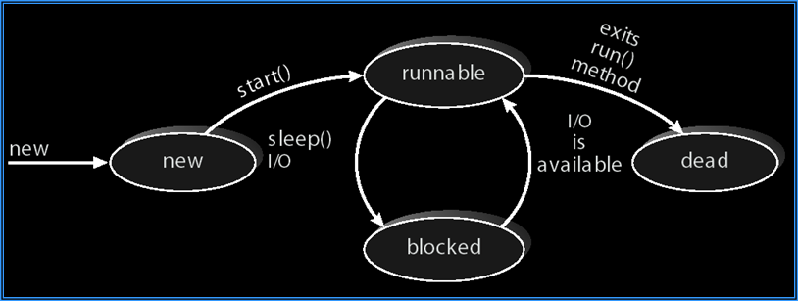
Java Thread States

Slide 32
POSIX API
  Pthread API provides routines for thread creation, termination and thread management.
  The pthread library provids function pthread_create() is used to create a thread.
  The waiting status os provided by the use of another pthread routing named as pthread_join()

Slide 33
Synchronization using Mutex
  A mutex is a special variable used to handle synchronization among threads. It has two states: locked and unlocked
  When the mutex is not available all requesting threads wait in the queue to hold the mutex.
  Mutex are used to take care that only one thread should enter in the critical section of a program.

Slide 34
Synchronization using Mutex
  pthread_mutex_init() function is used for initialization of mutex variable.
  The created mutex can be destroyed using pthread_mutex_destroy().
  A thread invokes pthread_mutex_lock() for acquiring a mutex block until the availability of the mutex.
  pthread_mutex_unlock() releases the mutex has been locked using locking function.

Slide 35
Synchronization using Condition Variables
  The condition variable is used for handling synchronization among threads.
  A condition variable allows a thread to suspend its execution until an associated condition becomes true.
  mutex_lock(m);
  if(A==B)
    mutex_unlock(m);

Slide 36
Condition Variable creation
  A condition variable is declared as a variable of type pthread_cond_t;
  Use pthread_cond_init() for initialization of condition variable.
  The creation condition variable can be destroyed using pthread_cond_destroy()

Slide 37
Condition Variable creation
  pthread_cond_wait() on the condition variable will unlock the mutex before locking the thread and it will relock the mutex before returning the code.
  pthread_cond_signal() and pthread_cond_broadcast() are used for handling of signal and broadcast operations.
  pthread_mutex_lock(&m);
  while(A != B)
    pthread_cond_wait(&cond1, &m);
    pthread_mutex_unlock(&m);

Slide 38
Read Write Locks
  POSIX provides read write locks for synchronization purpose.
  There are two types of access : A shared read access and exclusive write access.
  A variable of type read-write lock have three values : unlocked, read locked, write locked.

Slide 39
Read Write Locks
  A read write lock variable is declared using the type pthread_rwlock_t.
  Initialization is done using pthread_rwlock_init() function.
  pthread_rwlock_destroy() is used to release all the resources allocated to read-write lock.
  Read and write locks can be created using thread_rwlock_rdlock() and thread_rwlock_wrlock()

Slide 40
CPU Scheduler
  It selects from among the processes in memory that are ready to execute, and allocates the CPU to one of them.
  CPU scheduling decisions may take place when a process:
    Switches from running to waiting state.
    Switches from running to ready state.
    Switches from waiting to ready.
    Terminates.
  Scheduling are of Two Types.
    Preemptive Scheduling
    Non-Preemptive Scheduling

Slide 41
Five States Process Model

Slide 42
Non-preemptive vs. Preemptive
  Non-preemptive
    Once a process is in the running state, it will continue until it terminates or blocks itself for I/O
  Preemptive
    Currently running process may be interrupted and moved to ready state by the OS
    Preemption may occur when new process arrives, on an interrupt, or periodically.

Slide 43
Types of Scheduling
  Long-term scheduling is performed when a new process is created - This is a decision whether to add a new process to the set of processes that are currently active.
  Medium-term scheduling is a part of the swapping function - This is a decision whether to add a process to those that are at least partially in main memory and therefore available for execution.
  Short-term scheduling is the actual decision of which ready process to execute next.

Slide 44
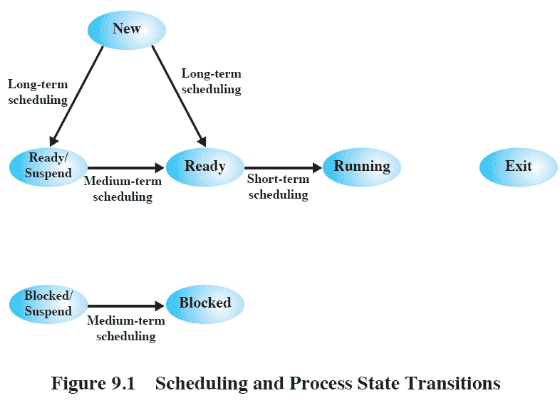
Process State Transitions

Slide 45
Scheduling Parameters
  CPU utilization – keep the CPU as busy as possible
  Throughput – Number of processes that complete their execution per unit time
  Turnaround time – amount of time to execute a particular process. It is summation of Waiting time and execute time.
  Waiting time – amount of time a process spends waiting in the ready queue
  Response time – amount of time it takes from when a request was submitted until the first response is produced, not output.

Slide 46
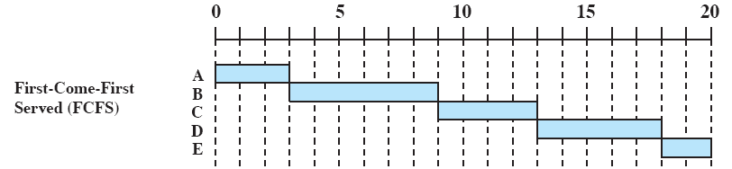
First Come First Served
  Each process joins the Ready queue, When the current process ceases to execute, the longest process in the Ready queue is selected
  A short process may have to wait a very long time before it can execute, Favors CPU-bound processes - I/O processes have to wait until CPU-bound process completes

Slide 47
Shortest Job First
  Associate with each process the length of its next CPU burst. Use these lengths to schedule the process with the shortest time.
  Two schemes:
    nonpreemptive – once CPU given to the process it cannot be preempted until completes its CPU burst.
    preemptive – if a new process arrives with CPU burst length less than remaining time of current executing process, preempt. This scheme is know as the Shortest-Remaining-Time-First (SRTF).
  SJF is optimal – gives minimum average waiting time for a given set of processes.

Slide 48
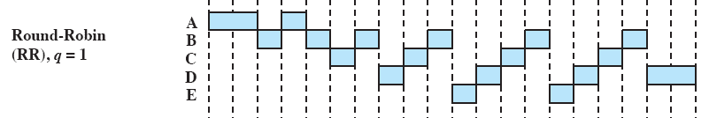
Round Robin
  Uses preemption based on a clock - also known as time slicing, because each process is given a slice of time before being preempted
  Clock interrupt is generated at periodic intervals
  When an interrupt occurs, the currently running process is placed in the ready queue - Next ready job is selected

Slide 49
Priority Scheduling
  The priority number (integer) is associated with each process
    The CPU is allocated to the process with the highest priority (smallest integer ≡ highest priority).
    Preemptive vs nonpreemptive
  SJF is a priority scheduling where priority is the predicted next CPU burst time.
  Problem is Starvation – low priority processes may never execute. Solution is aging – as time progresses increase the priority of the process.

